Slide 1
DOSE
VIRULENCE
INFECTION
HOST RESISTENCE
DOSE
Measurement of the bacteria burden present in the wound
VIRULENCE
Power of the microorganisms to produce disease or tissue damage
HOST RESISTENCE
Ability of body’s local and systemic defense mechanisms to resist bacterial invasion and damage
Figure 1: ﻿Bacterial Infection of Wounds Depends on Dose, Virulence and Host Resistance
Notes:
Figure 1: ﻿Bacterial Infection of Wounds Depends on Dose, Virulence and Host Resistance

Slide 2
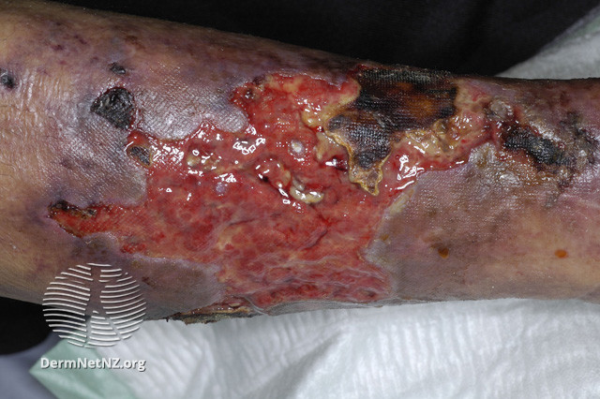
Figure 2: Ms. Basset’s Wound
Notes:
Figure 2: Ms. Basset’s Wound
Other leg ulcer Images can be found here: https://dermnetnz.org/topics/leg-ulcer-images/

Slide 3
Increasing Pain
Increased pain reported by the patient near the ulcer area
Erythema
Red or darkening skin colour near the ulcer
Classic Signs of Wound Infection
Edema
Shiny, tight skin or indentation in the skin within 4cm of the ulcer.
Heat
Increased skin temperature within 4cm of the ulcer relative to the skin 10cm from the wound.
Purulent Exudate
Tan, creamy green or yellow fluid present on a dry gauze removed one hour after placement on an ulcer.
Figure 3: ﻿Clinical Signs and Symptoms of Wound Infection
Notes:
Figure 3: ﻿Clinical Signs and Symptoms of Wound Infection

Slide 4
Critical Colonization
Local Wound Infection
Systemic Infection
Nonhealing
Bright red granulation tissue
Friable and exuberant granulation tissue
New areas of breakdown or necrosis on the wound surface
Increased exudate that is translucent before purulent
Unpleasant odour
Pain
Swelling induration
Erythema
Increases peri-wound temperature
Wound breakdown
Increased size or satellite areas
Undermining
Probing to bone
Fever
Rigors
Chills
Hypotension
Multiple organ failure
Figure 4: Clinical Signs and Symptoms of Wound Infection
Notes:
Figure 4: Clinical Signs and Symptoms of Wound Infection

Slide 5
Serous exudate and inflammation
Pocketing at base of wound
Thin watery fluid on a dry gauze removed one hour after placement on an ulcer
Smooth nongranulating pockets of ulcer tissue surrounded by red beefy granulation tissue
Delayed healing of the ulcer
Foul odour
No change or an increase in the volume or surface area of an ulcer over 4 weeks
Putrid or distinctively unpleasant smell
Friable and discoloured granulation tissue
Wound breakdown
Dusky or dull in colour and
bleeding when gently manipulated with a cotton applicator
Small open area in newly formed epithelial tissue not caused by trauma or re-injury
Figure 5: ﻿Signs Specific to Wound Healing by Secondary Intention
Notes:
Figure 5: ﻿Signs specific to wounds healing by secondary intention

Slide 6
Local
Behavioural
Wound size
Depth
Duration
Anatomic location
Blood perfusion
Mechanism of injury (contaminated penetrating objects)
Necrotic tissue
Foreign bodies
Nonadherence to advice regimen
Smoking
Drug and alcohol abuse
Nutrition and diet
Depressive illness
Lack of sleep and exercise
RISK FACTORS
Systemic
Medication
Vascular disease
Oedema
Diabetes mellitus
Renal failure
Immunodeficiency
Inherited neutrophil defects
Rheumatoid arthritis diseases
Immunosuppressive drugs
Cytotoxic drugs
Figure 6: Factors that Increase the Risk of Infection
Notes:
Figure 6: Factors that increase the risk of infection

Slide 7
Contamination or Wound Colonization
Local Wound Infection
Critical Colonization
Systemic Infection
Stage 1
Stage 2
Stage 3
Stage 4
Few subtle signs of infection
Some pain, odour or exudate
Healing processing normally
Increasing signs of infection
Increasing odour, pain, exudate
Healing no longer progressing normally
Overt signs of local infection
Discharge of pus with swelling, pain, erythema, and local warmth
Evidence of surrounding tissue involvement
Wound appears unhealthy or deteriorating
Cellulitis, lymphangitis, or gangrene
Overt signs of local infection and signs of systemic infection
Pyrexia and raised white blood cell count
Possible evidence of surrounding tissue involvement
May lead to sepsis and organ failure
Can be life threatening
Figure 7: Wound Infection Continuum
Notes:
Figure 7: Wound Infection Continuum

Slide 8
Signs of Infection
No signs other than healing process altered
Stages 1 & 2 Signs limited to wound only
Stage 3 Spreading local sepsis
Stage 4
Systemic signs
Are other risk factors present (i.e. malignancy or immunocompromise)?
Select topical antimicrobial
(box, bottom left)
Consider combination therapy. Drain any local collections
Start broad-spectrum systemic antibiotics while awaiting culture results
If systemic signs only, look outside wound for sources of infection
Overt signs of infection eliminated
Overt signs of infection not eliminated
Treat or correct the underlying etiology and refer to a specialist
If no improvement, are any other subtle signs of infection present? Or significant culture result?
Good clinical response
Poor clinical response
Select alternative microbial agent
Consider adding antibiotic
Factors to consider when selecting antimicrobials
Agent | Dressing
Specificity | Absorbency
Efficacy | Comfortability
Cytotoxicity | Odour Management
Allergenicity | Pain Management
Complete the course of antibiotics and reassess wound and patient
Adjust antibiotic selection according to causative agent, sensitivity, and patient preference
Stop antimicrobial therapy. Monitor wound progress. Continue managing would according to local protocol. Reconsider antimicrobial treatment if wound or patient status changes adversely
Figure 8: ﻿Algorithm for Managing Wound Infection
Notes:
Figure 8: ﻿Algorithm for managing wound infection

